Slide 1
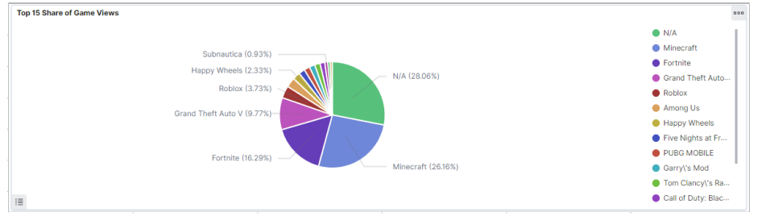
Project 1: YouTube “Gaming” Video Virality
David E. Nieves-Acaron
MTH 5320
13 October 2021
Dr. Ryan White

Slide 2
The Data
My hypothesis on what makes a video viral or popular is that there are four or so main components to it:
1. Thumbnail
2. Title
3. Channel
4. YouTube Algorithm Magic
5. The actual content of the video
Ended up making use of parts of 3 and 5.

Slide 3
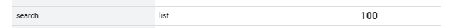
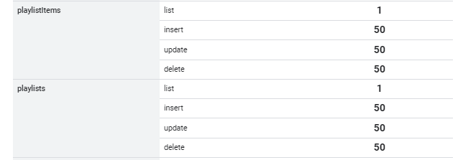
Data Collection (YouTube Data API)
Gathering a list of "gaming" channels on YouTube via their ID's
Getting a selected list of video ID's for those channels and writing that list to a local file
Iterating through list, gathering the necessary video information via a web scraper, and uploading the data to ElasticSearch

Slide 4
ElasticSearch Demo
Link

Slide 5
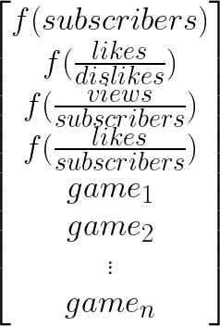
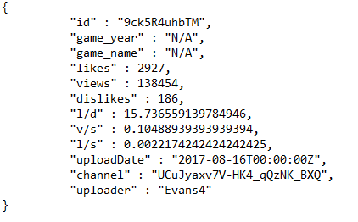
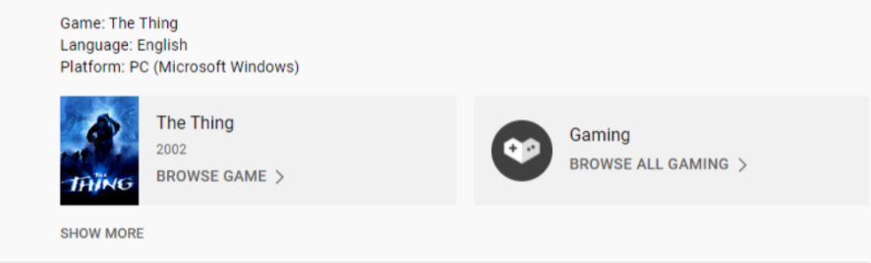
Data formatting

Slide 6

Benchmarking
I used a multi-class linear regression
Outputs:
At first, it got ok results (0.74 accuracy), and converged quickly.

Slide 7
Results
Tried out variations in activation functions, architectures, learning rates, and batch rates
Larger batch rates required very small learning rates.
Idea abandoned
Bigger layers improved the network slightly.
Sigmoid helped
Realistic Results
0.65 Accuracy using Sigmoid but without viewer/subscribers
0.53 without inputting subscribers or viewers/subscribers
Best result (so far)
0.96 Accuracy using Sigmoid and inputting viewer/subscriber ratio
Not totally unrealistic, but focus should be elsewhere
Title, thumbnail content, channel analytics, etc...

Slide 8
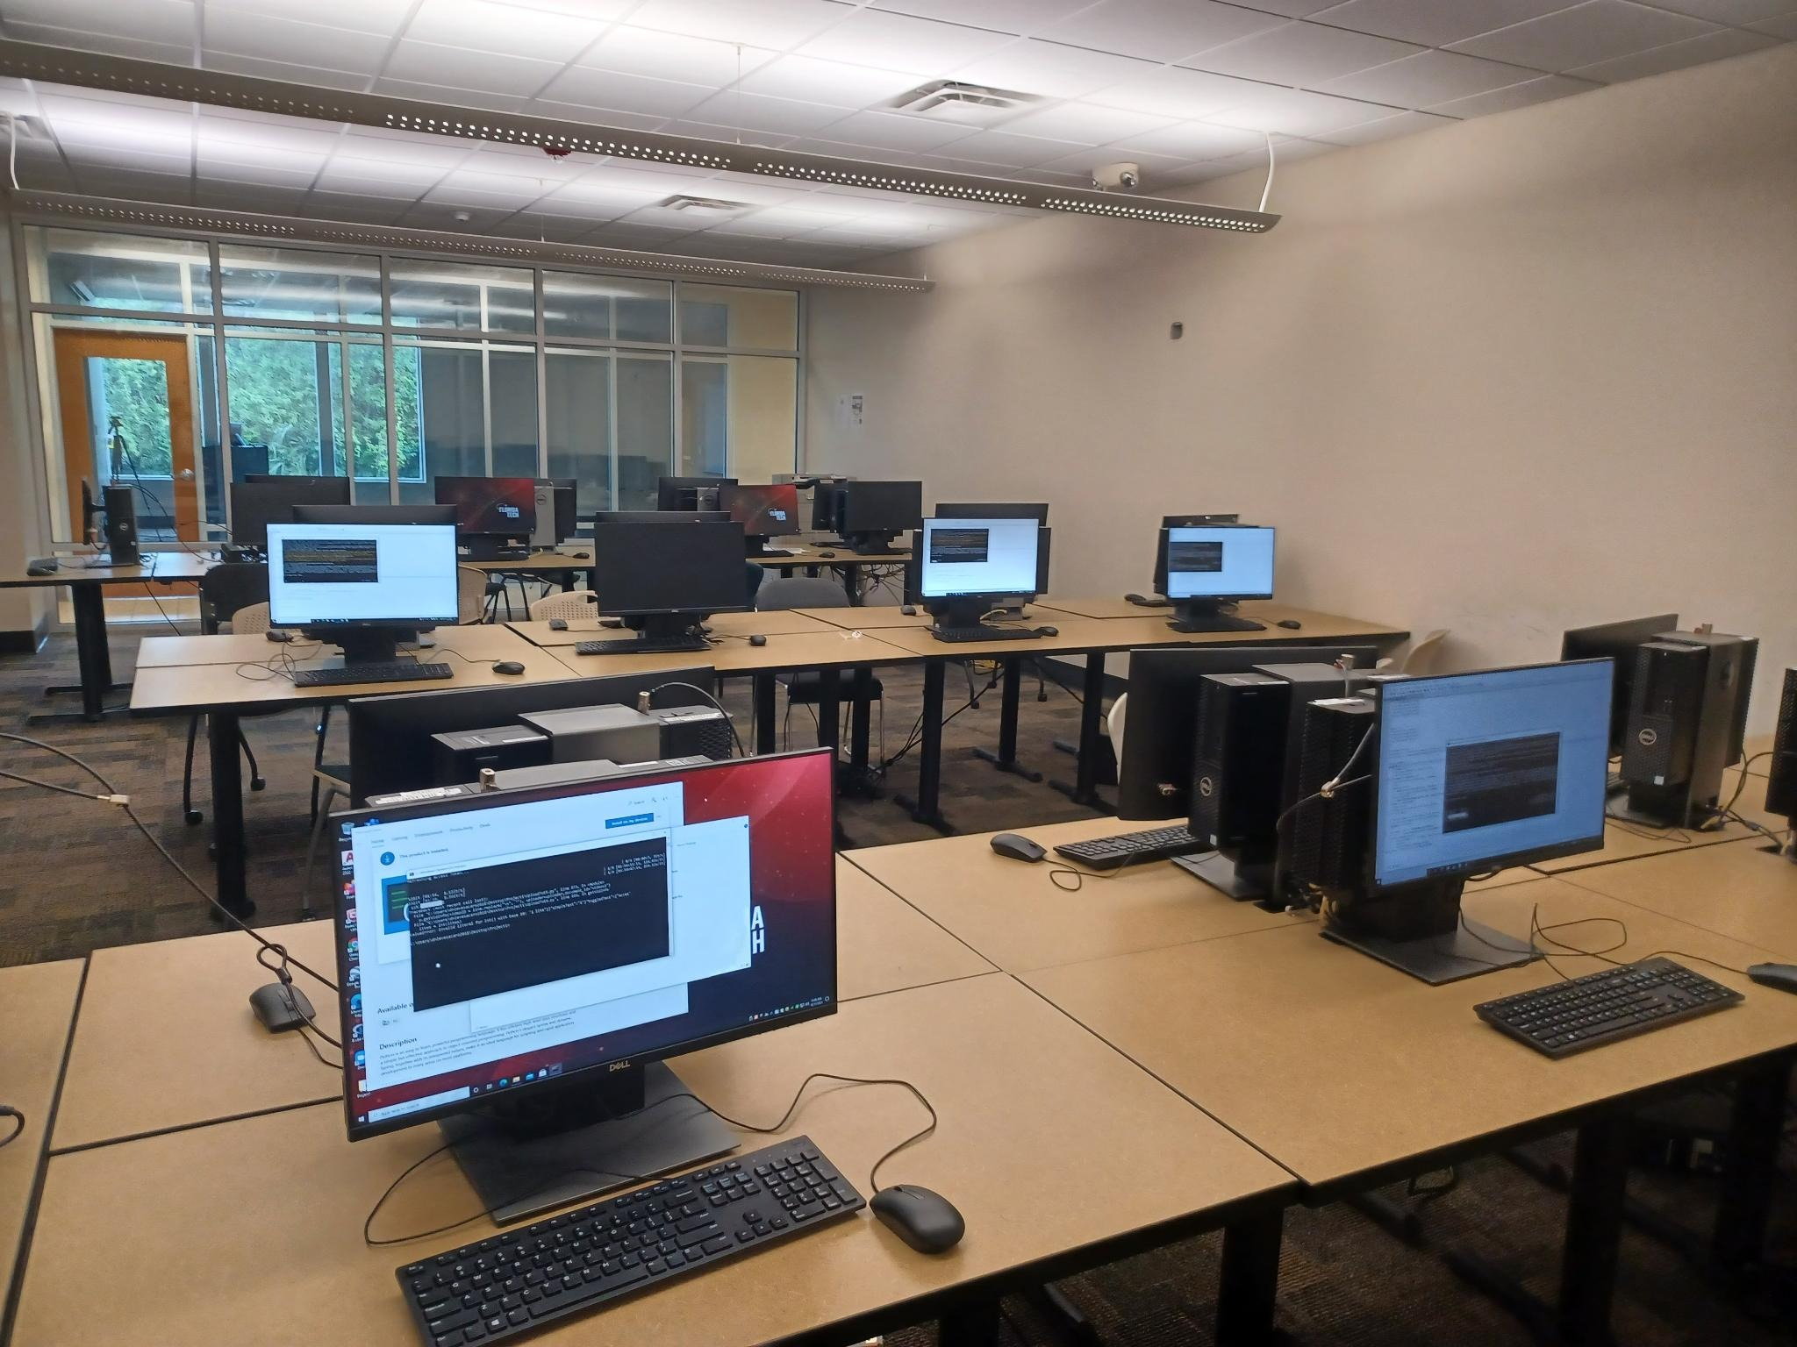
Conclusion
This is a naive approach
Other factors are not being taken into account
Title
Thumbnail
YouTube Algorithm
Takeaway: infrastructure to further develop other ways of predicting virality.

Slide 9
¿Questions?

